Slide 1
OBJECT ORIENTED PROGRAMMING
CSE 202
Lecture 0

Slide 2
Course Details
Course Code:- CSE 202
Course Name:- OBJECT ORIENTED PROGRAMMING
LTP:- 3 0 2 [3 lectures, 3 practical's/week]
Credits:- 4
Nature of Course:- Core

Slide 3
Course Outcomes
identify basic programming constructs and use the newly acquired skills to solve extensive programming problems.
discuss the mechanism of code reusability by creating own libraries of functions.
analyze the logic by designing code capable of passing various test cases.
interpret the principles of the object-oriented model and apply it in the implementation in C++ language.
categorize the theoretical knowledge and insights gained thus far to formulate working code
apply various programming constructs to build software applications

Slide 4
Program Outcomes achieved from the course
Apply the knowledge of mathematics, science, engineering fundamentals, and an engineering specialization to the solution of complex engineering problems.
Identify, formulate, review research literature, and analyses complex engineering problems reaching substantiated conclusions using first principles of mathematics, natural sciences and engineering sciences.
Design solutions for complex engineering problems and design system components or processes that meet the specified needs with appropriate consideration for the public health and safety, and the cultural, societal, and environmental considerations.

Slide 5
Program Outcomes achieved from the course
Create, select, and apply appropriate techniques, resources, and modern engineering and IT tools including prediction and modelling to complex engineering activities with an understanding of the limitations.
Recognize the need for, and have the preparation and ability to engage in independent and lifelong learning in the broadest context of technological change.

Slide 6
Program Educational Objectives achieved from the course
Apply acquired skills in software engineering, networking, security, databases, intelligent systems, cloud computing and operating systems to adapt and deploy innovative software solutions for diverse applications.
Apply diverse IT skills to design, develop, and evaluate innovative solutions for business environments, considering risks, and utilizing interdisciplinary knowledge for efficient real-time projects benefiting society.

Slide 7
Syllabus of CSE202
Unit I
Concepts and Basics of C++ Programming : Introduction to concepts of OOP and OOP Languages, Reading and writing data using cin and cout, Creating classes, Class objects, Accessing class members, Differences between Structures, Unions, Enumerations and Classes, Inline and Non-inline member functions, Static data members and static member functions, Differences between procedural and object oriented programming paradigms, Features of Input/output Streams Functions : Functions with Default parameters/arguments, Inline Functions, Manipulator Functions, Function overloading and Scope rules, Friend of a class (friend function and friend class), Reference variables, Differences between Call by value, Call by address and call by reference, Recursion (Function, Member Function)

Slide 8
Syllabus of CSE202
Unit II
Pointers, Reference Variables, Arrays and String Concepts : Void pointer, Pointer arithmetic, Pointer to pointer, Possible problems with the use of pointers - Dangling pointer, Wild pointer, Null pointer assignment, Classes containing pointers, Pointer to objects, this pointer, Array of objects, The Standard C++ string class-defining and assigning string objects, Member functions, Modifiers of string class, Differences between pointer and reference variables, Array declaration and processing of multidimensional arrays(inside main and inside class), Pointer to data member

Slide 9
Syllabus of CSE202
Unit III
Data File operations : Opening and closing of files, Modes of file, File stream functions, Reading/Writing of files, Sequential access and random access file processing, Binary file operations, Classes and file operations, Structures and file operation Constructors, Destructors and File Handling : Manager functions (constructors and destructor), Default constructor, Constructor with default arguments, Destructors, Parameterized constructor, Copy constructor , Initializer lists

Slide 10
Syllabus of CSE202
Unit IV
Operator Overloading and Type Conversion : Operator Overloading (unary operator, binary operator overloading), Type conversions - basic type to class type, class type to basic type
Inheritance : Inheritance Basics – derived class and base class, Types (simple, multi-level, multiple and hierarchical), Modes (private, protected, public inheritance), Overriding member functions, Order of execution of constructors and destructors, Resolving ambiguities in inheritance, Virtual base class, Aggregation and Composition.

Slide 11
Syllabus of CSE202
Unit V
Dynamic Memory Management and Polymorphism : Dynamic memory allocation using new and delete operators, Virtual destructors, Compile and run time polymorphism, Virtual functions, Dynamic constructors, Abstract classes and concrete class, Introduction to Self-Referential class, Pure virtual functions, Early binding and late binding, Memory leak and allocation failures
Unit VI
Exception Handling, Templates and Standard Template Library (STL) : Basics of exception handling, Exception handling mechanism, Throwing mechanism, Catching mechanism, Rethrowing an exception, Function template and class template, Class template with inheritance, Introduction to STL- Containers, Algorithms and iterators, Container - Vector and List

Slide 12
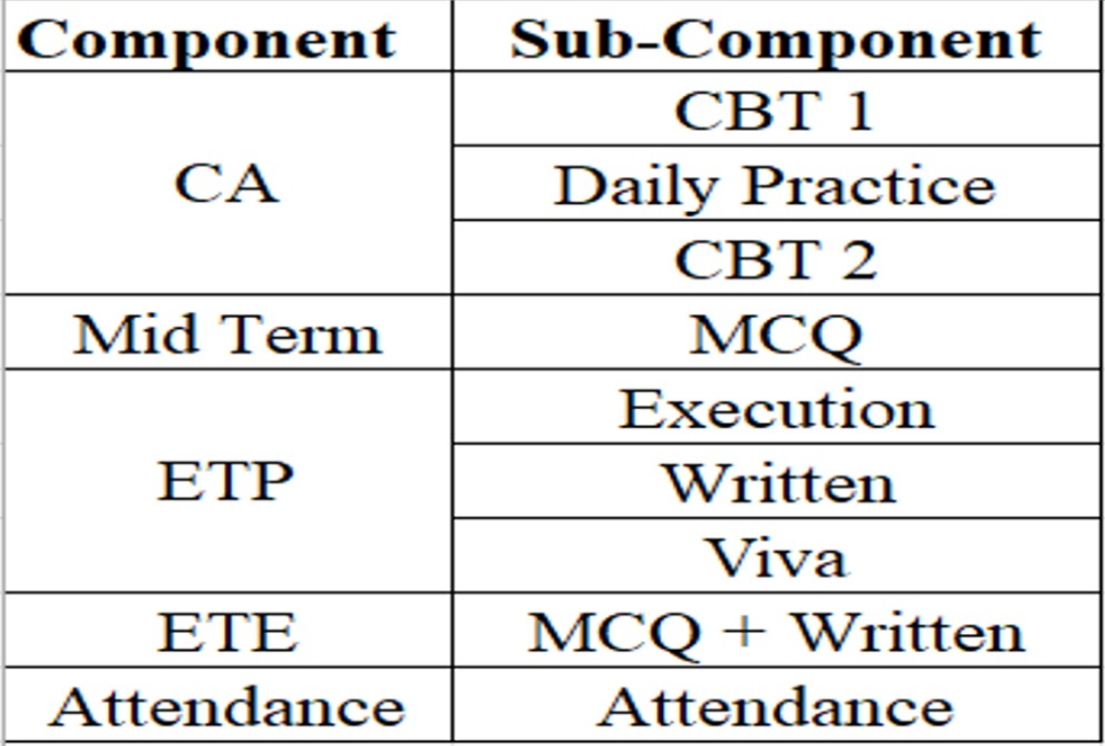

Tentative Course Assessment Model

Slide 13
Practice Problems
In the Practice Problems, marks are only for coding Problems.
MCQs are only for practice. No marks for MCQs.
In order to qualify for programming practice marks, the student must solve a minimum of 50% (50% Coding Problems + 50% MCQs) problems (eligibility condition)
Unit-wise Sequence locking

Slide 14
Daily Practice Problems
S. No | Unit | Question | Tentative Dates for Completion
1 | Unit-1 | At-least 15 Multiple Choice Questions and 21 Coding problems in each unit | 27th August 2026
2 | Unit-2 |  | 15th September 2026
3 | Unit-3 |  | 1st October 2026
4 | Unit-4 |  | 18th October 2026
5 | Unit-5 |  | 5th November 2026
6 | Unit-6 |  | 20th November 2026
Note:- Most Important for the improvement of Performance in Course Assessments.
21 coding questions in each unit divided into:
- 6 Static Questions(solve within the class)
- 15 Non-Static Questions(self-practice)

Slide 15
Important information
Programming practice- Student will complete it unit-wise on the IamNeo platform.
All code-based tests will be conducted on the IamNeo platform.
ETP will be conducted on the IamNeo platform.
URL: https://lpucolab438.examly.io/login
User Name: RegistrationNumber@neocolab.ai
Password: Registration Number

Slide 16
Why OBJECT ORIENTED PROGRAMMING?
Object and Classes
Real world modelling
Encapsulation
Wrapping
Data Abstraction
Hiding of non required information
Inheritance
Reusability

Slide 17
Why OBJECT ORIENTED PROGRAMMING?
Polymorphism
Many forms
Data Hiding
Security
Message Passing
Communication

Slide 18
Skillset
Programming Skills
Logic building
Code analysis

Slide 19
MOOCs(Massive Open Online Courses)
Not Applicable

Slide 20
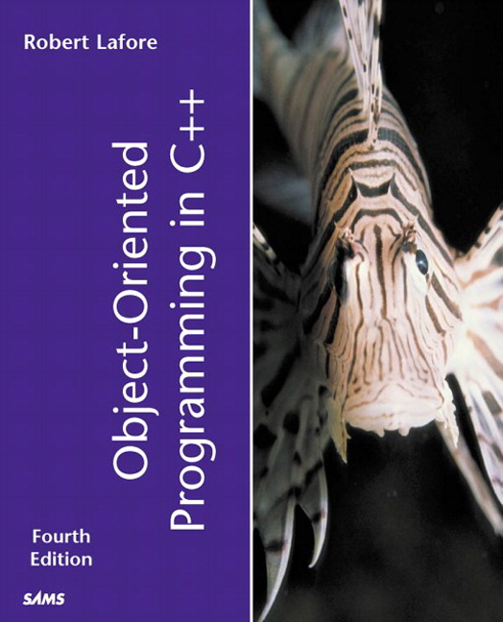
Text/Reference books
Text Book
“OBJECT ORIENTED
PROGRAMMING IN C++”
by
Robert Lafore

Slide 21
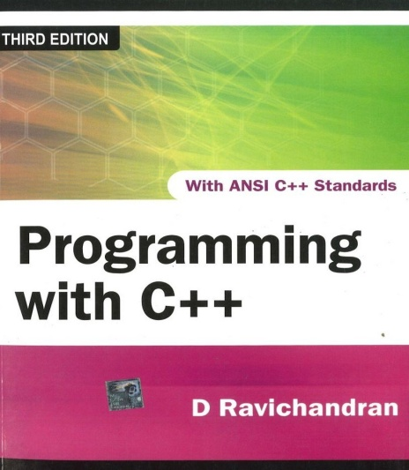
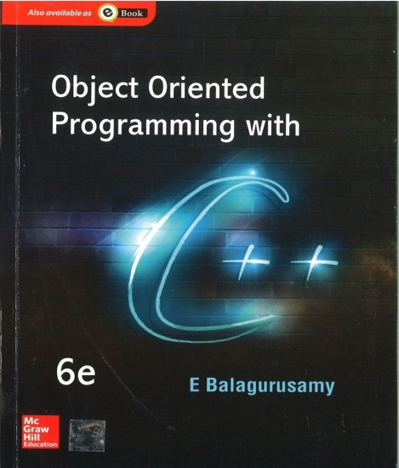
Text/Reference books
PROGRAMMING WITH C++
by D RAVICHANDRAN
OBJECT ORIENTED
PROGRAMMING IN C++
by E BALAGURUSAMY
PROGRAMMING WITH C++
by D RAVICHANDRAN
OBJECT ORIENTED
PROGRAMMING IN C++
by E BALAGURUSAMY

Slide 22

WHAT IS EDUCATION REVOLUTION?
Edu-Revolution at LPU is a transformative academic initiative aimed at creating a flexible, inclusive, and experiential learning environment.
Promotes student-centric learning by integrating real-world experiences, industry engagement, gamified learning practices, entrepreneurial activities, and extracurricular contributions into the formal academic framework.

Slide 23
Why EDU-Revolution!!!
  Career Readiness
  Enhance Real World Skills
  Promote Innovation and Creativity
  Foster Industry Relations
  Develop Entrepreneurial Mindset
  Increase Student Engagement and Motivation
  Promote Lifelong Learning

Slide 24
Education Revolution: an approach that encourages…
Gamified Learning with AI focus - Learning Outside Classroom
Revenue Generation by Students
Career (not just degree)
Students in Decision Making

Slide 25
Pillar I: Gamified Learning with AI focus
50% Learning outside the classroom
50% attendance outside the classroom
50% grades outside the classroom
Formula: 50-50-50
Techniques of Learning Outside the Classroom
Projects
Technical Competitions & Hackathons
Social Media Presence
Recognition of Prior Learning
Paid Internship
Recruitment/Competitive/ Eligibility Examination
NPTEL/MOOCs
Community Service
Publications/Patents/ Copyrights

Slide 26
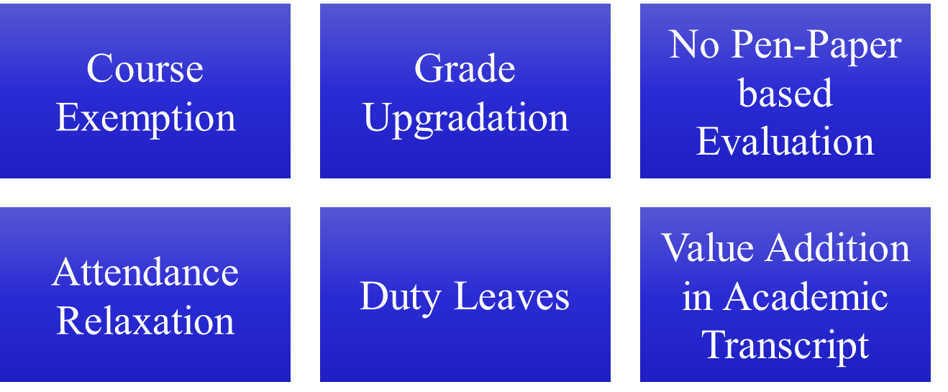
Gamified Learning: Benefits

Slide 27
Recognition of Prior Learning (RPL) for Object Oriented Programming (Under EduRev)
The course “Object Oriented Programming" is included under the Recognition of Prior Learning (RPL) scheme offered by EduRev.

Slide 28
How RPL is Applicable
Under the EduRev RPL Framework, the following process is followed:
1. Eligibility for RPL
Learners who believe they already possess the skills and knowledge covered in the Object Oriented Programming course may apply for RPL within the specified timelines.
2. Assessment Process
Once the RPL application is accepted, the student will be required to appear for an RPL assessment/examination. This assessment is designed to evaluate the learner’s knowledge of Object Oriented Programming.

Slide 29
Interfaces and Contact Information
UMS link to apply for EDU Revolution initiatives:
UMS Navigation --- LMS → EDU Revolution: BE THE CHANGE
In case of any query in this regard, the student can approach for resolution through RMS at the following path:
UMS Navigation--- Relationship management system → EDU Revolution: BE THE CHANGE
OR get your queries resolved through the Helpline Number: 01824-520150.

Slide 30
Pillar II: Revenue Generation
Where would Revenue Generation come from?
Industry/field consultancy projects
Freelancing activities
Paid internships
Establishing start- ups and entrepreneurial venture
Through University support:
  Earn while Learn opportunities
  Incentives for Publication/Patent/Copyright
You should be able to generate at least 50 % age of your semester fee every semester

Slide 31
Pillar II: Revenue Generation
Course Exemption/Grade upgradation
Student Centric Revenue Generation
Duty Leave
Important Points:
Submit authentic information only
Student must submit a detailed proposal outlining:
Revenue Model
Market Feasibility
Execution Strategy
Financial Projections
Earn exemptions from your revenue generation endeavors
Earn Academic benefits on revenues above 50,000 (in 6 months)

Slide 32
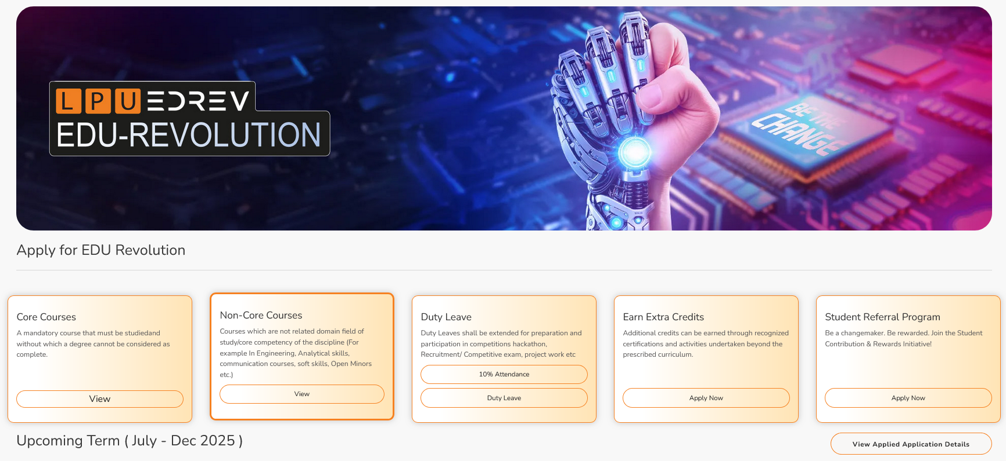
Where to View & Select Nomination Choices for Courses that students are studying
Step 1: Login to UMS -- Navigate to LMS -- EDREV: Be the Part of Change -- Options.

Slide 33
Applying for EDU-Revolution Initiatives
How can students apply:
Login UMS → LMS → EDU-Revolution: Be the Change → Apply for EDU- Revolution
Need Help:
Students can visit the EDU-Revolution Query & Assistance Zone at Block 27–102

Slide 34
Applying for EDU-Revolution Initiatives
Important Points
All student applications will be verified by the EDU-Revolution Standing Committee and the Committee may:
  Contact you directly
  Ask for supporting documents
  Call for in-person interaction
  Can approve/reject/change proposed benefits
  Final decisions are based on merit, relevance & evidence

Slide 35

Pillar III: Career Pathway
"Your Journey, Your Choice: Build, Serve, or Study for Tomorrow!"

Slide 36
Pillar III: Career Pathway
Career Pathways are at the core of our academic framework.
Curriculum is strategically designed to align with needs and requirements of each career pathway.
From technical proficiency to soft skills, the curriculum is tailored to develop a well-rounded professional ready for competitive market as per the chosen pathway.

Slide 37
Pillar III: Career Pathway
School Specific Success Stories for each pathway
(Highlighting student and their achievement for each pathway)

Slide 38
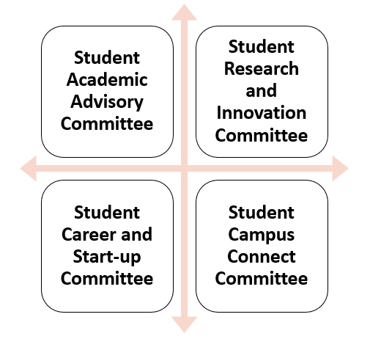
Pillar IV: Students in Decision Making
Committees under Student Education Revolution Board
We bring numerous ideas every year; but now, at least 20% of these ideas should originate from students themselves in all categories like academics, placements, research, entrepreneurship, etc.

Slide 39
Pillar IV: Students in Decision Making
A platform to bring the Change
Curriculum
Content
New Teaching Methods
New Evaluation Methods
Academic Benefits
Research Area
Projects to Pursue
Funding opportunities
Identification of Real World Problems
Academic Benefits
National/International Internship
Bring New companies
International Placement opportunities
Entrepreneural Areas
Academic Benefits
Social Media Presence of Schools
Social Media Campaigns
Self Promotion
Academic Benefits

Slide 40

Zero Lecture Feedback
Please refrain from including your name or registration number in your feedback. Your honest and candid feedback are valued and appreciated. Kindly fill out the feedback separately for each subject.
Or
Visit URL: https://forms.gle/pksSDrADkNLde4dBA
Thank you !!!

Slide 41



Slide 42


